Slide 1
Ray Tracing
Writing a Very Simple Version

Slide 2
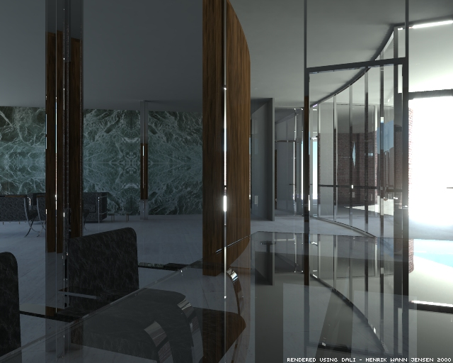
What Makes a Good Picture?
Contents (3D models).
Lighting.
Reflection.
Shadow.
Surface textures.
image from the animation "The Light of Mies van der Rohe“
http://graphics.ucsd.edu/~henrik/images/global.html

Slide 3
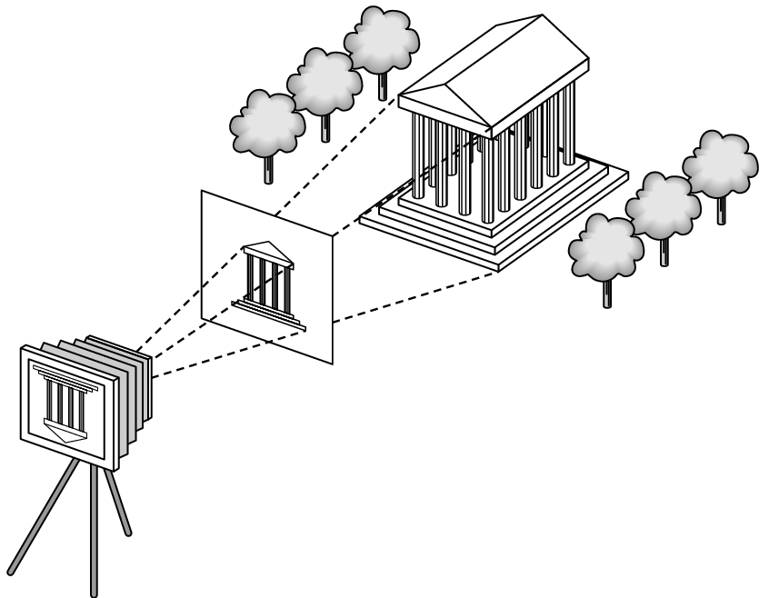
Synthetic Camera Model
projector
p
image plane
projection of p
center of projection

Slide 4
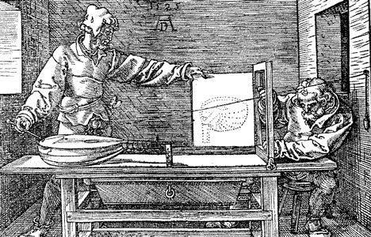
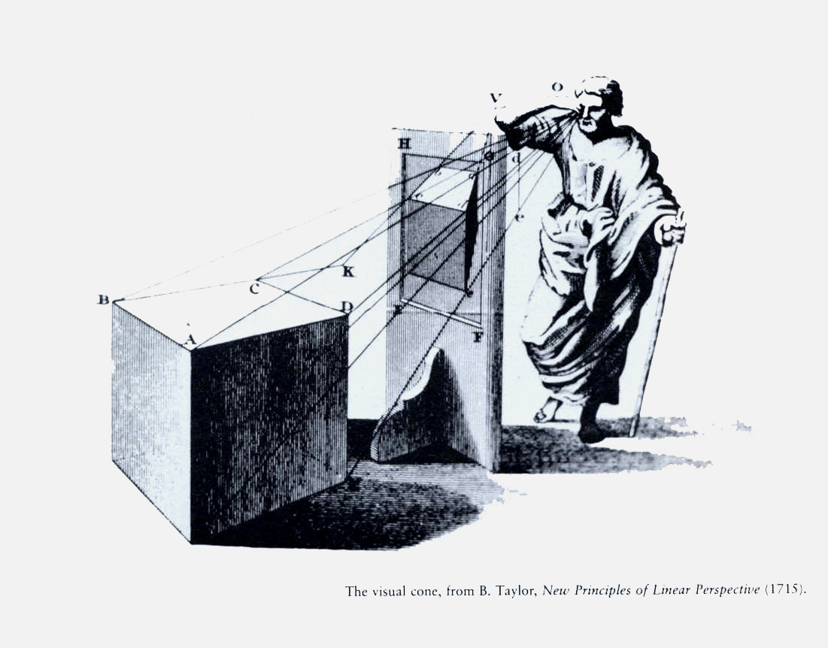
Albrecht Dürer's 1525 woodcut "Drawing a Lute" showing the construction of a perspective projection. Copyright New York City Public Library.

Slide 5
Method A: Object Order Algorithm
(Process one polygon at a time.)

Slide 7
3D to 2D Projection
OK, so we can map a 3D point (or vertex) to 2D image.
But what about a 3D surface?
Polygons are made from points.
Actually, we only need triangles!

Slide 8
Scan Conversion
Also called rasterization.
The 3D to 2D Projection gives us 2D vertices (points).
We need to fill in the interior.

Slide 9
Method B: Screen Order Algorithm
(Process one pixel at a time.)

Slide 10
Ray Tracing Algorithm
An overview in Pharr’s 1.2
More detail in Watt’s 10.3.1 (pp.284-286) and 12.2-12.4 (pp.342-354)
Transmitted
Reflected

Slide 11
Creating a Ray
Parameters:
  Image Plane (position, size, and resolution)
  Viewpoint
  Which ray goes from the eye to pixel (a, b)?

Slide 12
Creating a Ray
Simplified cases for a 256x256 image:
  UL (upper left) corner maps to pixel (0, 0)
  UR (upper right) corner maps to pixel (255, 0)
  It is then easy to find pixel (a, 0)

Slide 13
Wait!
Does the ray for Pixel (0, 0) really go through the UL corner?
Does the ray for Pixel (0, 255) really go through UR corner?
(The error could be ignored for now. It is also rather easy to fix.)

Slide 14
Define the Projection Plane
Given:
  Viewpoint (or eye position, camera position): E
  Viewing direction: D
  Upward direction (usually the sky): U
Find the 4 corners of the projection screen
  First, find the center of the screen (E + D * d)
  You may define your own distance (d)
  The X/Y directions of the screen may be obtained by:
    X = D x U and Y = D x X
  Extend to the corners
Then divide the screen into pixels.
  Q: Use the pixel center or corner?

Slide 15
Ray-Object Intersection
Ray:
(x,y,z)=(x₁,y₁,z₁)+t(x_{d},y_{d},z_{d})
Sphere:
  (x-x₀)²+(y-y₀)²+(z-z₀)²=r²
Find t that satisfy
  (x-x₀)²+(y-y₀)²+(z-z₀)²=r²
What does it mean if t < 0?
Normal vector?
Also easy for planes, cones, …etc.
P1
d
t*d
r
O

Slide 16
Ray-Object Intersection
Plane: (x,y,z)= V₀ + s₁*(V₁ -V₀ )+ s₂*(V₂ -V₀ )
Ray: (x,y,z)= (x₁,y₁,z₁) + t (x_{d},y_{d},z_{d})
Find s₁, s₂ , t that produce the same (x,y,z)
Intersection found if
  0≤ s₁, s₂ ≤ 1 and t > 0
V₂
V₁
V₀

Slide 17
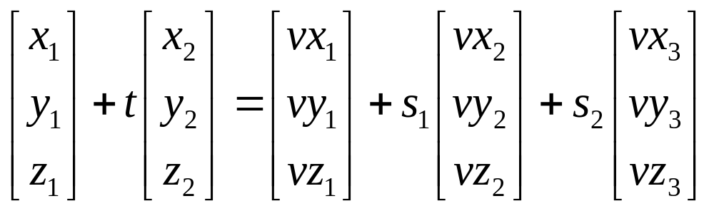
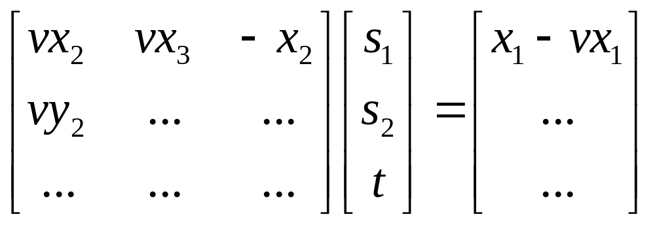

Slide 18
Ray-Triangle Intersection
Intersection found if:
  t > 0 and
  s₁+s₂ ≤ 1
  Now you can handle
  3D OBJ models!!
V₂
V₀
V₁

Slide 19
Möller–Trumbore Algorithm
A fast method for calculating the intersection of a ray and a triangle in 3D.
See: Fast, Minimum Storage Ray/Triangle Intersection, Möller & Trumbore. Journal of Graphics Tools, 1997.

Slide 20
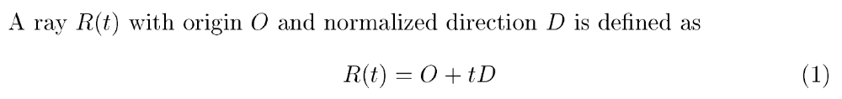
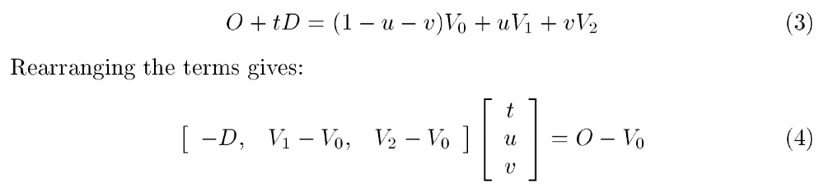
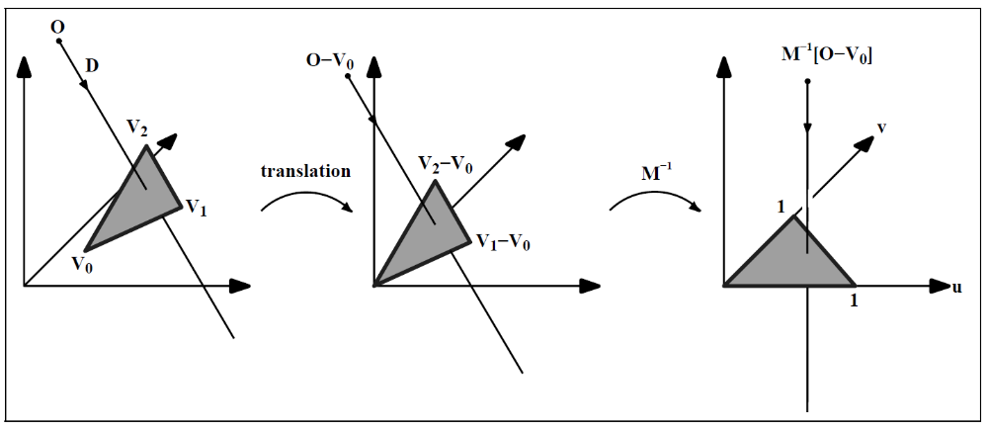
Source: https://dl.acm.org/citation.cfm?id=272315

Slide 21
Assignments 1 & 2 – A Ray Tracer
Split into two parts.
Part A due in 2 weeks.
  Camera module
  Object module
  No recursive ray tracing
  Simple output (just black and white)
The rest (Part B) are due in 2 more weeks.

Slide 22
Required Modules
Ray Generation Module
Ray Object Intersection Module
Shading Module (Recursive Rays Gen.)
Display (Output) Module

Slide 23
Ray Generation Module
Reads camera setup from input files.
Definition of eye position and image plane in 3D coordinates.
Generates a ray if given image screen coordinates (x, y)
  Note that x and y may be real numbers (not integers).

Slide 24
Intersection Module
Sphere and triangle types only (for now).
Ray-object intersection.
Light (for Part B).

Slide 25
Shading Module
Integration of other modules.
Shading (for Part B).
Spawn reflected and refracted rays.

Slide 26
Part A
Ray generation module
Ray-object intersection module
  Spheres and triangles only
Shading module:
  No shading. No reflection and refraction.
Display module
  Output to PPM files

Slide 27
Ray-Object Intersection
For example: sphere
  (x-x₀)²+(y-y₀)²+(z-z₀)²=r²
Ray: (x,y,z)=(x₁,y₁,z₁)+t(x_{d},y_{d},z_{d})
Find t that satisfy
  (x-x₀)²+(y-y₀)²+(z-z₀)²=r²

Slide 28
Output to PPM Format
A image forma that is easy to support
IO code available as ImageIO.[c,h]
Download IrfanView (freeware) to view the generated output images.
It is also described in Peter Shirley’s “Ray Tracing in One Weekend”
  https://raytracing.github.io/books/RayTracingInOneWeekend.html#outputanimage

Slide 29
Usage of ImageIO.c
int main(int argc, char* argv[]) {
ColorImage image;
int x, y;
Pixel p={0,0,0};
initColorImage(256, 256, &image);
for (y=0; y<256; y++) {
for (x=0; x<256; x++) {
p.R = y; writePixel(x, y, p, &image); } } outputPPM("reds.ppm", &image);
}

Slide 30
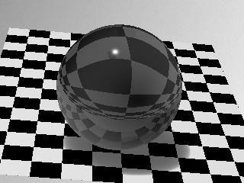
HW2 (Part B)
Objects materials
  Color and reflections
  Checkerboard.
Shading module:
  Add shading, reflection, and refraction.
Display module:
  PPM library will be provided.
Add a demo scene of your own.

Slide 31
SHADING, REFLECTION, REFRACTION

Slide 32
Shading Models
Pixel color = ambient + diffuse + specular + reflected + transmitted
The weight of each is determined by the surface properties.
We will discuss each of them within the next a few lectures.

Slide 33
Lighting (Shading) & Shadow
Point light is easy to implement.
How to determine a surface point is in the shadow? Use a shadow ray (from intersection point to light).
Shading will be introduced in the next lecture.

Slide 34
Reflection and Refraction
Reflected ray is determined by:
  incoming ray and normal vector.
Refracted ray is determined by:
  Incoming ray
  Normal vector
  And density
Snell’s law:
η_{I} sin θ_{i} = η_{t} sin θ_{t}
θ_{i}
θ_{t}

Slide 35
Recursive Algorithm
The reflected ray, refracted ray, and shadow ray are traced recursively.
Termination condition:
  Depth of trace
  Weight (to the final pixel color) of ray

Slide 36
Advantage
We get all the following automatically:
  Hidden surface removal
  Shadow
  Reflection
  Transparency and refraction

Slide 37
Disadvantage
Slow. Many rays are spawned.
Slow. Ray-object intersection for every ray and every object. (We will discuss how to avoid this in the next lecture).
The lighting is still not completely right!

